Slide 1
Change log
September 2021
Updated title slide to bring in line with content theme
Updated copyright information on all slides

Slide 2
Introduction to Amazon EKS
Containers Immersion Day: Module 5

Slide 3
AWS container services landscape
Management
Deployment, Scheduling, Scaling & Management of containerized applications
Amazon Elastic
Container Service
Amazon Elastic
Kubernetes Service
Hosting
Where the containers run
Amazon EC2
AWS Fargate
Image Registry
Container Image Repository
Amazon Elastic
Container Registry
Notes:
We’ve already spent some time talking about the current AWS container services landscape.
For this module, we’re going to focus on at the orchestration or management layer and explore Amazon EKS.
We will also look at how you can currently run your containers on EKS using on of two Launch Types: either the EC2 launch type – where get to manage the the underlying instances on which your containers are running - or you can choose to run your containers in a serverless manner with the AWS Fargate launch type.

Slide 4
Amazon Elastic Kubernetes Service (EKS) is a fully managed Kubernetes service. EKS runs upstream Kubernetes and is certified Kubernetes conformant.

Slide 5

Kubernetes Concepts
Node
Docker
Pod
Containers
Pods: Co-located group of containers that share an IP, namespace, storage volume
ReplicaSet
#Pods—2
label selector: v1
ReplicaSet
#Pods—1
label selector: v2
Replica Set: Manages the lifecycle of pods and ensures specified number are running
Pod
Pod
Pod
v1
v1
v2
“web”
Service: Single, stable name for a set of pods, also acts as LB
Label: Used to organize and select group of objects
port 8080
port 8080
Notes:
For those of you not too familiar with Kubernetes, let’s start with a quick overview of some core concepts.
Pods - Co-located group of containers that share an IP, namespace, storage volume
Replica Sets - Manages the lifecycle of pods and ensures specified number are running
Services - Single, stable name for a set of pods, also acts as LB
Labels - Used to organize and select group of objects

Slide 6
Kubernetes Concepts
Namespaces: “Virtual” clusters for users/projects
Ingress controller: L7 load balancing
Deployments: Declarative version updates
Jobs: Run to completion
Autoscale: Automatically adjust number of Pods
Network Policies: AKA Security Groups for Pods
StatefulSet: Support for long-term stateful distributed systems
More…

Slide 7
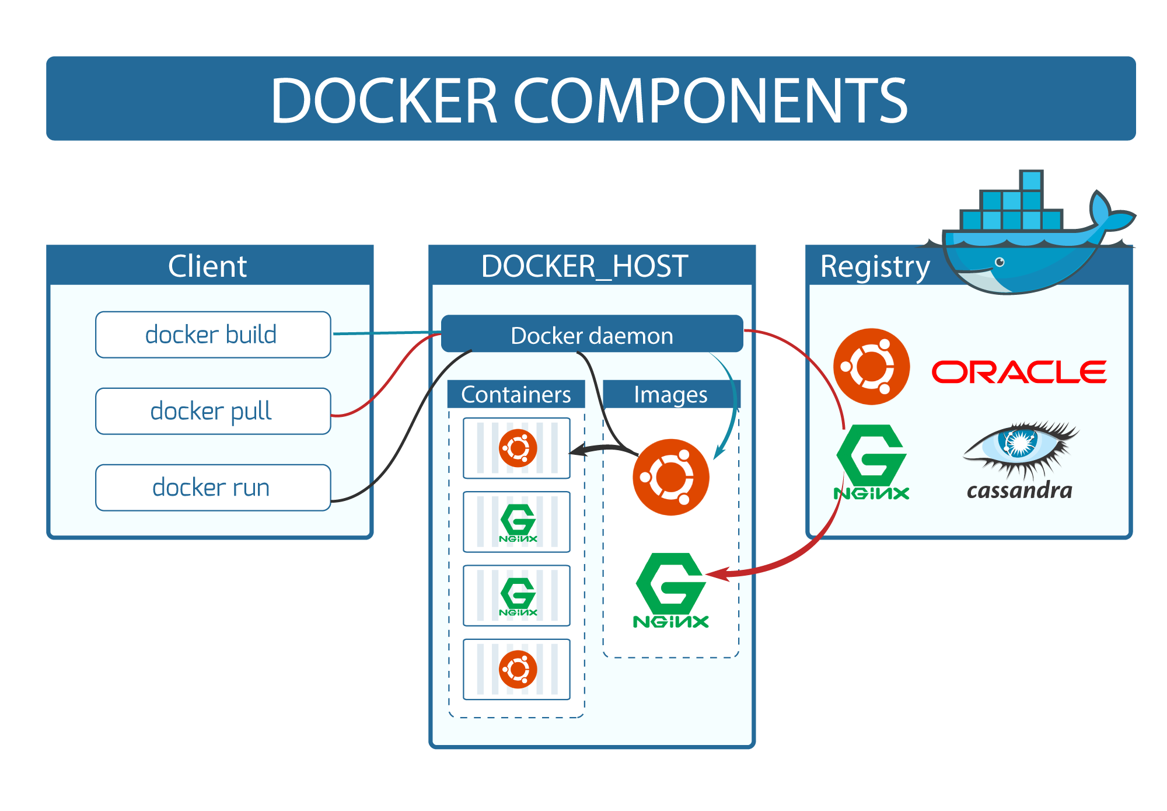

Notes:
Start with the basics of how Docker works.
You have a Docker Daemon that pulls container images from a Registry and starts them turning them into running Containers. It then manages their lifecycle.
You can control that process with the docker client or with an API.

Slide 8
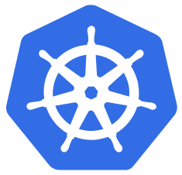
kubelet
Notes:
With Kubernetes this is exactly the same thing except:
that instead of you running docker run commands yourself with the CLI the Kubernetes kubelet that runs on each machine does it on your behalf.
The ECS version of the kublet is called the ECS Agent but it is much the same idea.

Slide 9
kubelet
kubelet
Control Plane
kubelet
kubelet
Notes:
kubelets are, told what to do by the Kubernetes control plane
Kublets as pushes information about what is happening on each node back up to the control plane help to with its scheduling decisions.
As you grow to many worker nodes an orchestrator like Kubernetes doing this for you becomes more and more essential.

Slide 10
What does EKS do for you over running Kubernetes on EC2?
We deploy the Kubernetes Control Plane and etcd in a highly-available configuration across 3 AZs
We manage that control plane for you in a similar way to our managed relational database service RDS
We provide a network (CNI) plugin that integrates Pod networking natively with AWS VPC
We integrate/federate user access to the Kubernetes CLI (kubectl) and API with AWS IAM
Notes:
You can run Kubernetes yourself via virtual machines on our EC2 so what does EKS do for you over doing it yourself?
(CLICK)
We deploy the Kubernetes Control Plane and etcd in a highly-available configuration across 3 AZs
(CLICK)
And we manage that control plane for you in a similar way to our managed relational database service RDS
(CLICK)
We provide, and actually require that you use, a network (CNI) plugin we’ve opensourced that integrates Pod networking natively with AWS VPC
(CLICK)
And we integrate/federate user access to the Kubernetes CLI (kubectl) and API with AWS IAM via our aws-iam-authenticator plugin

Slide 11

EKS is Kubernetes Certified
EKS runs upstream Kubernetes and is certified as Kubernetes conformant.
This means that applications managed by Amazon EKS are fully compatible with applications managed by any standard Kubernetes environment.
Notes:
Things to mention:
Amazon EKS runs upstream Kubernetes and is certified Kubernetes conformant,
Applications managed by Amazon EKS are fully compatible with applications managed by any standard Kubernetes environment.

Slide 12

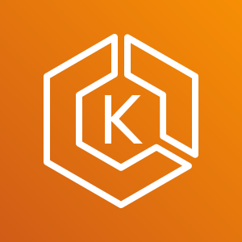

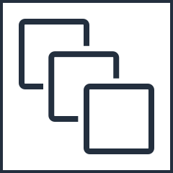
Amazon EKS Architecture
kubectl
Amazon EKS
prod-cluster-123.eks.amazonaws.com
VPC
EKS workers
Your AWS account
Notes:
Things to mention:
At a high level, the EKS architecture includes worker nodes in the form of EC2 Instances and a managed EKS control plane to provide capacity to run your Pods.

Slide 13




EKS Control Plane
Availability Zone 1
Availability Zone 2
Availability Zone 3
VPC
Highly available and single tenant infrastructure
All “native AWS” components
Separate etcd to help with safe and seamless ops/upgrades
Fronted by an NLB - which enables Private endpoints into your VPC
NLB
Amazon EKS
API Servers
Etcd
Notes:
Going a bit deeper, the control plane is made up of at least five EC2 instances we run dedicated for you and this cluster in our account.
There are at least two API server instances in different Availability Zones and a quorum of three Etcd instances across three AZs.
This means that every customer, and every cluster, is on its own single-tenant HA infrastructure. It is also why we charge for the control plane as we incur this five EC2 instance cost for each one you spin up.

Slide 14
Networking
Introduction to Amazon EKS

Slide 15



Private EKS API Endpoints
Control Plane VPC (AWS account)
Public == false
Private == true
etcd
etcd
API Server
API Server
AZ 1
AZ 2
Worker VPC (your account)
EKS-owned ENIs
Private hosted zone
prod-cluster-123.eks.amazonaws.com
Kubectl
Worker node
Worker node
Kubelet
Kubelet
Kube-proxy
Kube-proxy
AZ 1
AZ 2
Notes:
The first network consideration to be aware of with EKS is whether the control plane API endpoints, used by kubectl as well by your worker nodes to communicate with the control plane, are public or private.
EKS launched with this as being public-only but has since made this granular so you can have them be only-public, only-private or both public and private. In most situations I’d suggest making them only-private.
We recently launched a capability, so that when only the private endpoint is enabled, Amazon EKS automatically advertises the private IP addresses of the private endpoint from the public endpoint. This means that you can easily connect to your EKS cluster over a peered VPC or over a Direct Connect.

Slide 16


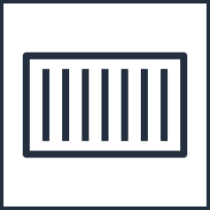

Pod Networking with EKS
ec2.associateaddress()
ENI
10.0.0.20
10.0.0.1
10.0.0.2
10.0.0.22
Instance 1
ENI
Instance 2
Secondary IPs:
10.0.0.1
10.0.0.2
Secondary IPs:
10.0.0.20
10.0.0.22
VPC Subnet – 10.0.0.0/24
https://github.com/aws/amazon-vpc-cni-k8s
Notes:
With EKS we require you to use our network, or CNI, plugin. This plugin turns everything back into normal ENIs and IPs within your AWS VPC network.
Under this model Pods each get their own additional ‘real’ VPC IP off an Elastic Network Interface or ENI. This means that EKS can have a high density of Pods to network interfaces and instances but that you can’t count fully leverage Security Groups bound to ENIs for network segregation - as two unrelated Pods can be using the same ENI and therefore security group.
What happens is that when a pod is scheduled
(CLICK)
Our CNI plugin will go and get an additional IP, assign it to an ENI, and then
(CLICK)
Map that pod to that IP and network interface.
(CLICK)

Slide 17
Load balancing
All three Elastic Load Balancing products are supported
NLB and CLB supported by Kubernetes Service type=LoadBalancer
Internal and External Load Balancer support

Slide 18
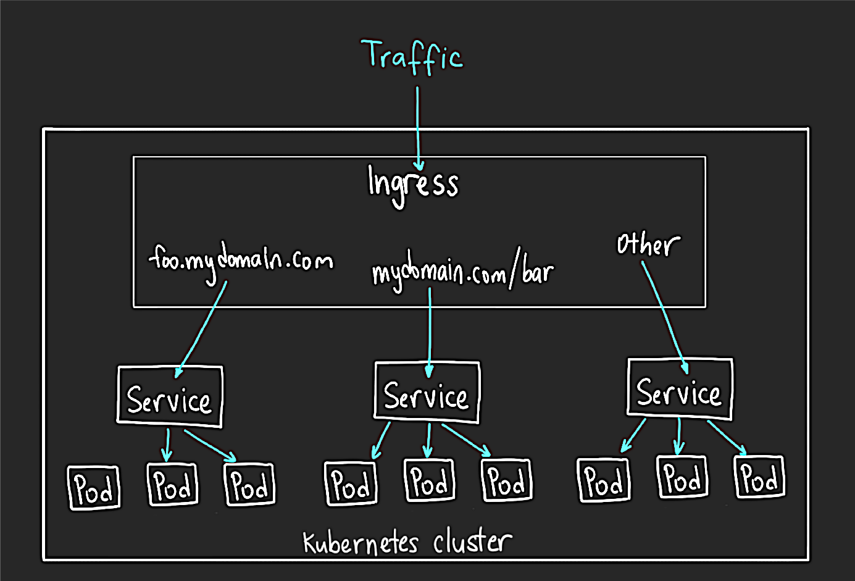
Kubernetes Ingress object
Exposes HTTP/HTTPS routes to services within the cluster
Many implementations: ALB, NGINX, F5, HAProxy etc.
Default service type: ClusterIP
Notes:
SAY: Ingress exposes HTTP and HTTPS routes from outside the cluster to services within the cluster. Traffic routing is controlled by rules defined on the Ingress resource.

Slide 19

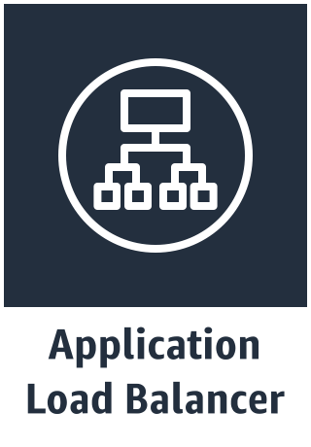

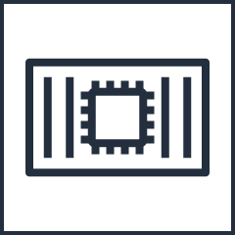
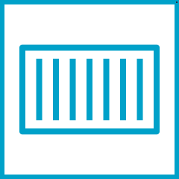
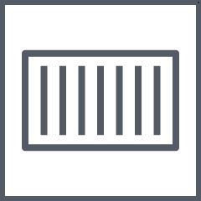
AWS Load Balancer Controller
HTTPS Listener
HTTP Listener
AWS Resources
Rule: /charcuterie
Rule: /cheeses
TargetGroup: Blue (Instance Mode)
TargetGroup: Green (IP Mode)
Ingress Resource Creation via Kubectl or API
NodePort
NodePort
Kubernetes Cluster
Node
Node
Node
Kubernetes API Server
ALB Ingress Controller
Notes:
SAY: The AWS Load Balancer Controller manages AWS Elastic Load Balancers for a Kubernetes cluster.
The controller provisions the following resources.
An AWS Application Load Balancer (ALB) when you create a Kubernetes Ingress.
An AWS Network Load Balancer (NLB) when you create a Kubernetes Service of type LoadBalancer. In the past, the Kubernetes in-tree load balancer was used for instance targets, but the AWS Load balancer Controller was used for IP targets. With the AWS Load Balancer Controller version 2.2.0 or later, you can create Network Load Balancers using either target type. For more information about NLB target types, see Target type in the User Guide for Network Load Balancers.
The controller was formerly named the AWS ALB Ingress Controller

Slide 20

AWS Load Balancer Controller
Supported by Amazon EKS team
Open-source development: https://github.com/kubernetes-sigs/aws-load-balancer-controller
Customers are using it in production today!
Reduce costs by sharing an ALB across multiple namespaces
NLB supported with Fargate tasks

Slide 21
Security
Introduction to Amazon EKS

Slide 22
Shared Responsibility Model
Customer Data
Responsible for Security “in” the cloud
CUSTOMER
Applications
Platform
Identity & Access Management
Operating System
Network and Firewall Configuration
Compute
Storage
Database
Networking
Responsible for Security “of” the cloud
AWS
Regions
Availability Zones
Edge Locations
Notes:
The first item we’ll look at is Identity and Access Management.

Slide 23


IAM = Who can do what in the platform and/or cluster?
People
Code / Pipelines
Photo & Licence
Photo & Licence
Notes:
When we talk about Identity and Access Management it is about controlling who can do what in the platform and the container cluster.
Usually there are two cases here – controlling what people can do and controlling what code or automated pipelines can do.

Slide 24

And you should invest in end-to-end automation via pipelines
AWS Infrastructure-as-Code
Code & Container Builds
Security (DevSecOps)
Deployments (don’t run kubectl to deploy to prod on your laptop!)
Invest here to make it fast and easy/automatic for your team to do the right thing!
Photo
Notes:
Speaking of Automated Pipelines – you really should automate everything - for security reasons in addition to the usual operational ones.
This includes:
The underlying AWS account and its VPC network
Your Code & Container Builds
Which should embed security tests in addition to your unit and integration tests as a required step before, finally,
Your deployments
The goal here is to make it as fast and as easy as possible for your team to do the right thing!

Slide 25
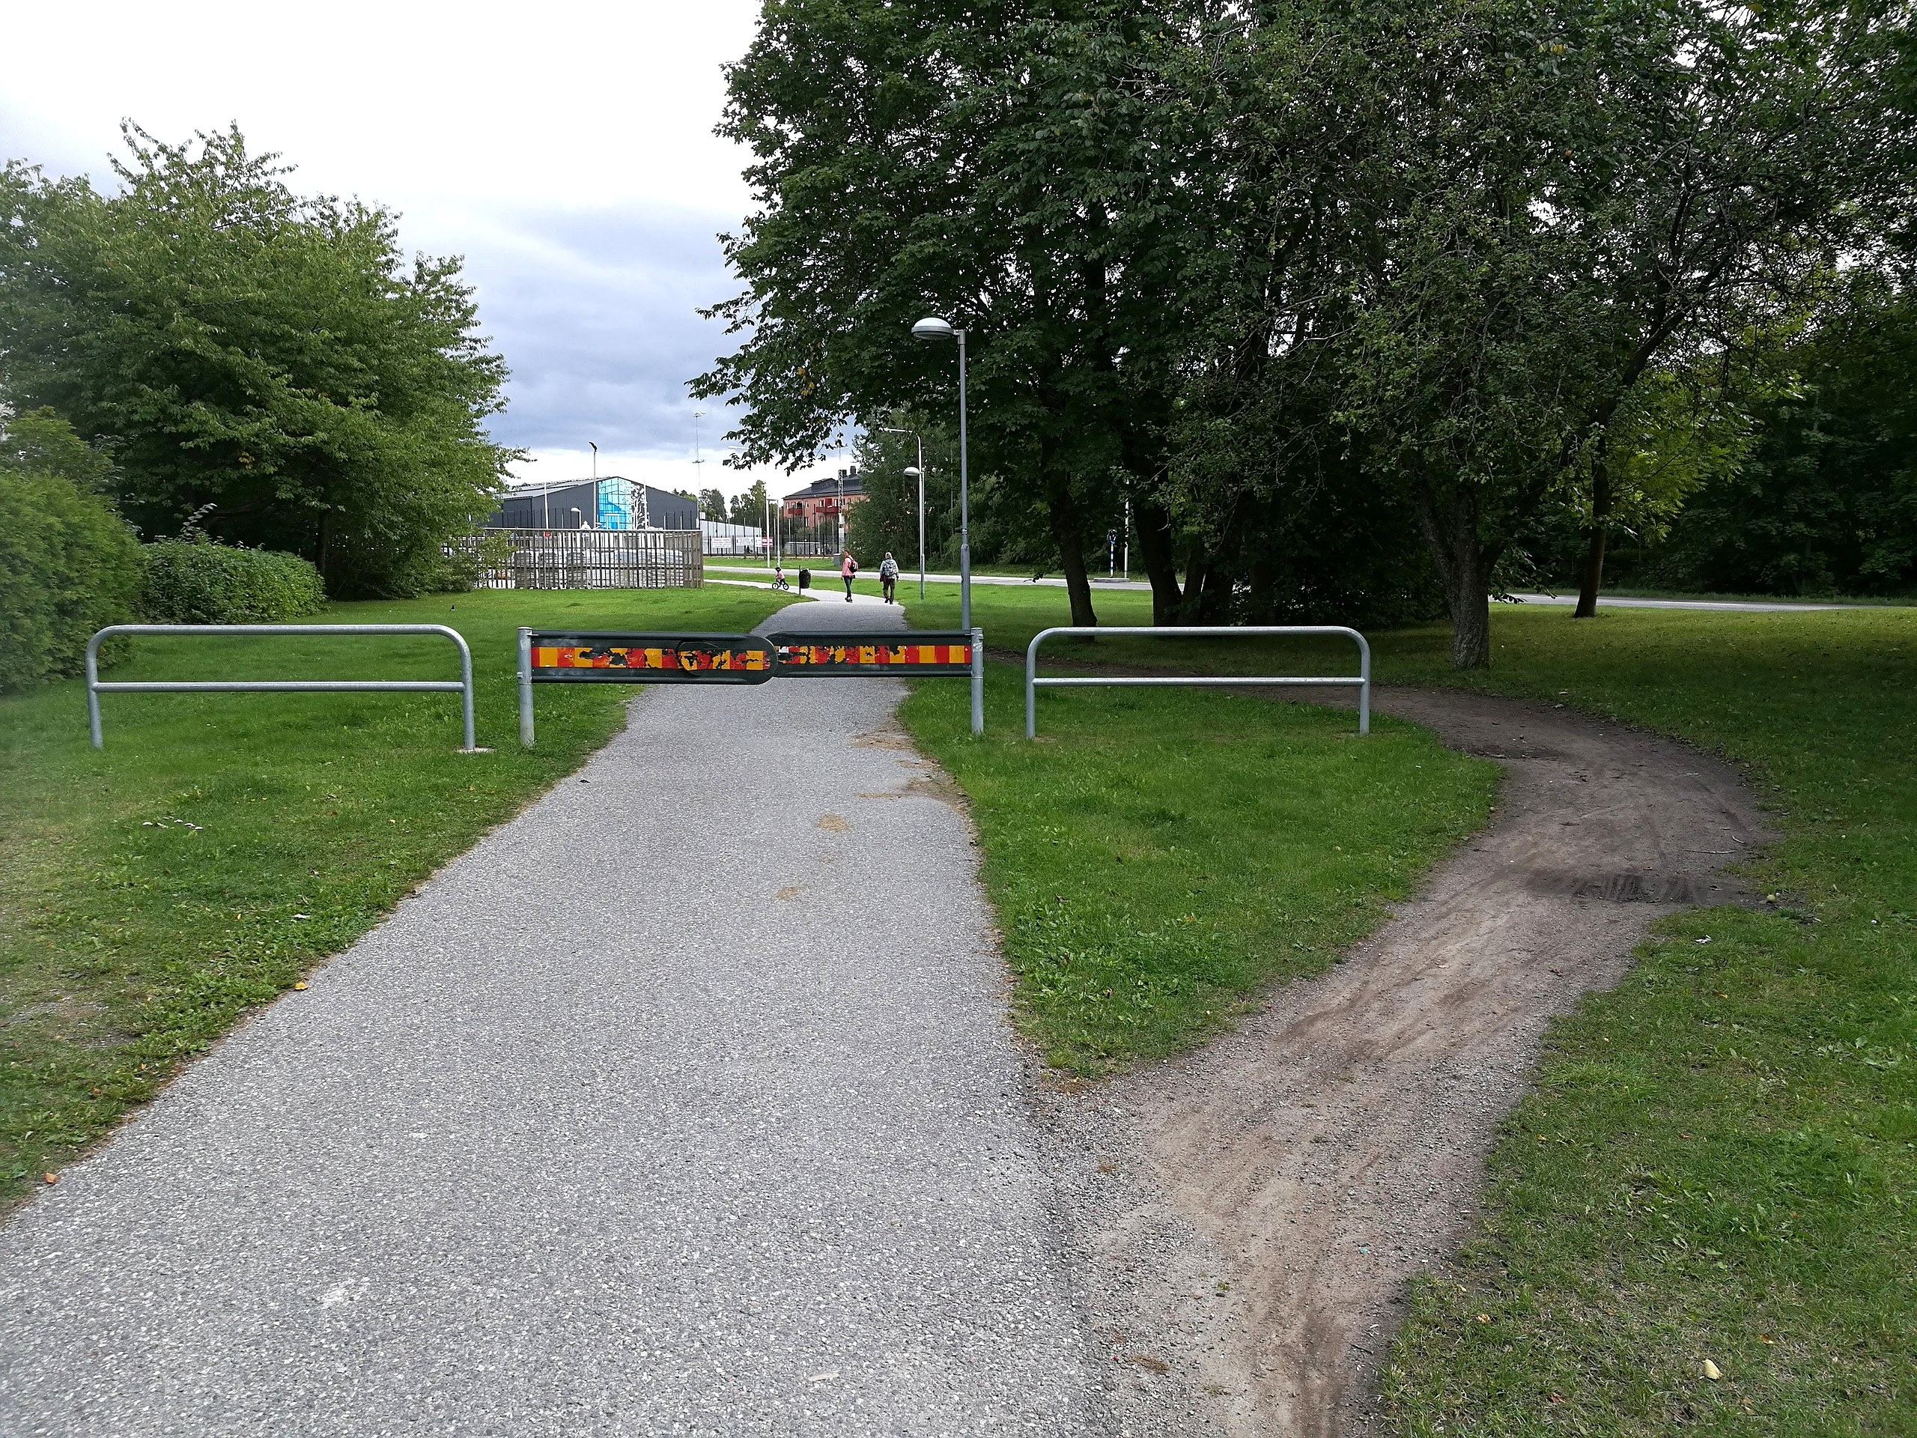
Why do DevSecOps which embeds security in CI/CD pipelines?
If you don’t make it fast and easy to do the right thing people will just go around the policies or restrictions to get their work done and meet their deadlines!
Photo & Licence
Notes:
The reason why DevSecOps has taken off is that embedding security into your pipelines and processes, and making it as fast and easy as possible, makes it much more likely that it’ll happen and people won’t just go around it to get their work done and meet their deadlines!

Slide 26


EKS: IAM Authentication + kubectl
Passes AWS Identity
1
Verifies AWS Identity
4
2
K8s action allowed/denied
K8s API
AWS IAM Authentication
kubectl
3
Authorization of AWS Identity against Kubernetes RBAC
Notes:
With EKS, and its required AWS IAM Authenticator, you sign into the cluster with an AWS IAM Identity – either an IAM User or IAM Role. But Kubernetes decides what they can do there via its RBAC.
The way that this process works is:
(CLICK)
1) When a Kubectl call is made - let’s say I’ve made a get pods call, my IAM identity is passed along with the Kubernetes call by our IAM Authenticator plugin. It looks in the default credential chain for my IAM ID - config file in the .aws folder, IAM role assigned to instance, etc.
(CLICK)
2) On the backend, Kubernetes verifies the IAM identity with AWS IAM. This is purely for authentication.
(CLICK)
3) The auth response is sent back to Kubernetes, and K8s checks its internal RBAC mapping for this now authenticated principal. This determines if my original get pods call was allowed or denied.
(CLICK)
4) The K8s API approves or denies the request and returns the results to me.
(CLICK)

Slide 27
Note: Whatever IAM user/role creates the cluster is a permanent hidden (can’t see it in the AWS console or via kubectl) full admin on the cluster! Ideally create it with a dedicated user/role that you limit access to like you would your AWS root account.

Slide 28
Kubernetes RBAC Basics
Kubernetes has Roles which are defined and apply within a single namespace (a virtual cluster) and ClusterRoles which apply cluster-wide across all namespaces.
You define custom roles describing resources (such as pods and nodes) and which verbs (such as get, update and delete) are allowed against them.
kind: ClusterRole
metadata:
name: cluster-admin
rules:
- apiGroups:
- '*'
resources:
- '*'
verbs:
- '*'
- nonResourceURLs:
- '*'
verbs:
- '*'
Notes:
I won’t go into exhaustive detail about Kubernetes RBAC as it is pretty well described in their documentation, and in the training for their Certified Kubernetes Administrator certification. But I’ll touch on some of the basics.
Kubernetes has Roles which are defined within and apply to a single namespace – which are the logical separation within Kubernetes similar to what accounts are within AWS. It also has ClusterRoles which apply cluster-wide across all namespaces.
With both you define rules describing resources, and the verbs that area allowed against them, by principals that are logged in as that Role.

Slide 29
Kubernetes RBAC built-in ClusterRoles
Default ClusterRole | Description
cluster-admin | Allows super-user access to perform any action on any resource. When used in a ClusterRoleBinding, it gives full control over every resource in the cluster and in all namespaces. When used in a RoleBinding, it gives full control over every resource in the rolebinding's namespace, including the namespace itself.
admin | Allows admin access, intended to be granted within a namespace using a RoleBinding. If used in a RoleBinding, allows read/write access to most resources in a namespace, including the ability to create roles and rolebindings within the namespace. It does not allow write access to resource quota or to the namespace itself.
edit | Allows read/write access to most objects in a namespace. It does not allow viewing or modifying roles or rolebindings.
view | Allows read-only access to see most objects in a namespace. It does not allow viewing roles or rolebindings. It does not allow viewing secrets, since those are escalating
Notes:
Kubernetes has a few built-in Roles that you can use to assign a least privilege to people or pipelines to complete their work. These are a bit blunt and often customers use them as inspiration to make their own more granular ones.

Slide 30
Shared Responsibility Model
Customer Data
Responsible for Security “in” the cloud
CUSTOMER
Applications
Platform
Identity & Access Management
Operating System
Network and Firewall Configuration
Compute
Storage
Database
Networking
Responsible for Security “of” the cloud
AWS
Regions
Availability Zones
Edge Locations
Notes:
Next we’ll talk about the platform services and settings required to be secure in the cloud with your containers.

Slide 31
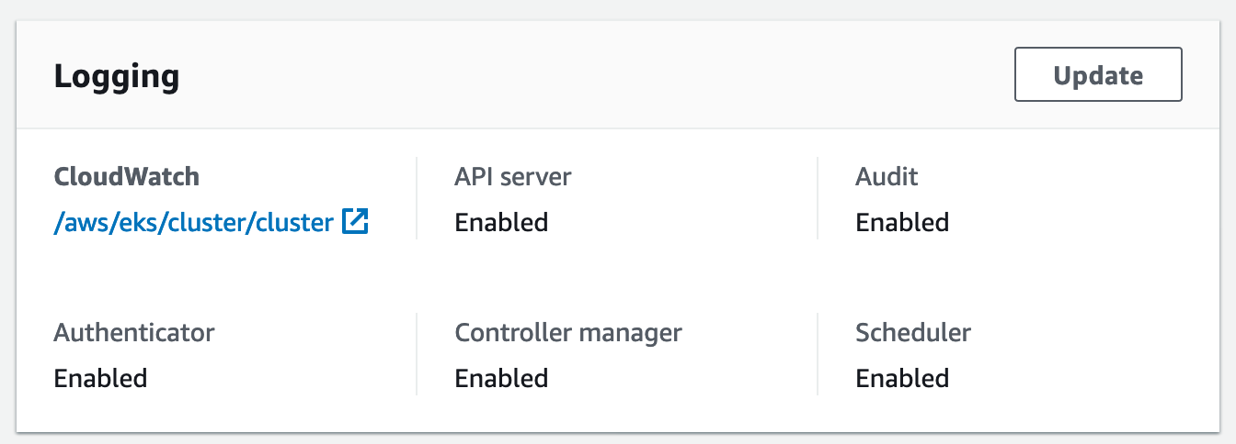
Logging and Auditing the Control Plane
Logging of the control plane, especially around an audit trail of API actions, is an important aspect of security and being able to work out who did what.
When using EKS you can (and should) enable such logging to CloudWatch Logs.
Notes:
Having an audit trail of what happens – who did what when – is an important element of security and being able to successfully investigate any breaches of it.
When creating an EKS cluster either via the console or via eksctl logging this to CloudWatch Logs defaults to disabled and you need to ask for it via turning it on or passing an additional parameter – you should definitely do that.

Slide 32
Shared Responsibility Model
Customer Data
Responsible for Security “in” the cloud
CUSTOMER
Applications
Platform
Identity & Access Management
Operating System
Network and Firewall Configuration
Compute
Storage
Database
Networking
Responsible for Security “of” the cloud
AWS
Regions
Availability Zones
Edge Locations
Notes:
Next we’ll talk about the network and firewall configurations for ECS and EKS.

Slide 33

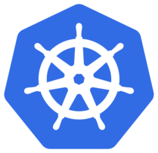
Installing a Network Policy Provider on Kubernetes
Firewalling within Kubernetes is controlled by NeworkPolicies. You first need to add a Network Policy Provider to EKS / Kubernetes in order to use Network Policies. A popular one covered in our documentation is Calico.
https://docs.aws.amazon.com/eks/latest/userguide/calico.html
Notes:
The first step in using Network Policies, which is Kubernetes’ built-in network firewall functionality, is installing a Network Policy Provider. A common choice is Calico’s – and this is the one we explain how to install and use in our EKS documentation.

Slide 34

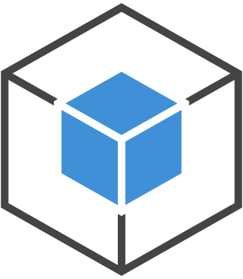
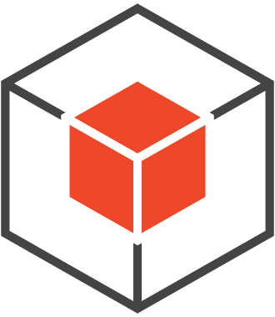
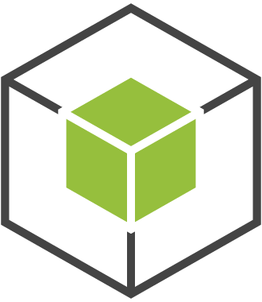
Network Policies on Kubernetes
catsndogs-namespace
kind: NetworkPolicy
apiVersion: extensions/v1beta1
metadata:
name: default-deny
spec:
podSelector:
matchLabels: {}
Cats
Dogs
Frontend
Notes:
So how do Network Polices on Kubernetes work?
Here is an example of 3 microservices that can all talk to each other. If I want to create segmentation boundary between these microservices, I can apply default-deny rule in the NetworkPolicy and apply to this namespace.

Slide 35
Network Policies on Kubernetes
catsndogs-namespace
kind: NetworkPolicy
apiVersion: extensions/v1beta1
metadata:
name: default-deny
spec:
podSelector:
matchLabels: {}
Cats
Dogs
Frontend
Notes:
Now none of them can communicate with each other or be reached from the Internet.

Slide 36
Network Policies on Kubernetes
catsndogs-namespace
apiVersion: extensions/v1beta1
kind: NetworkPolicy
metadata:
name: public-to-frontend
spec:
podSelector:
matchLabels:
role: frontend
ingress:
- from:
- ipBlock:
cidr: "0.0.0.0/0"
ports:
- protocol: TCP
port: 80
Cats
Dogs
Frontend
Notes:
If I want to expose only my frontend microservice to the Internet, I can do so with this example NetworkPolicy allowing 0.0.0.0 to talk to it as an Ingress rule.

Slide 37
Network Policies on Kubernetes
catsndogs-namespace
apiVersion: extensions/v1beta1
kind: NetworkPolicy
metadata:
name: public-to-frontend
spec:
podSelector:
matchLabels:
role: frontend
ingress:
- from:
- ipBlock:
cidr: "0.0.0.0/0"
ports:
- protocol: TCP
port: 80
Cats
Dogs
Frontend
Notes:
And now I have my Frontend open to the Internet once again.

Slide 38
Network Policies on Kubernetes
catsndogs-namespace
apiVersion: extensions/v1beta1
kind: NetworkPolicy
metadata:
name: frontend-to-cats
spec:
podSelector:
matchLabels:
role: cats
ingress:
- from:
- podSelector:
matchLabels:
role: “frontend”
ports:
- protocol: TCP
port: 80
Cats
Dogs
Frontend
Notes:
If I wanted to then allow the Frontend service to talk to the Cats service I can add this ingress rule which uses a PodSelector matching pods with the label “frontend” instead of on an IP subnet as before.

Slide 39

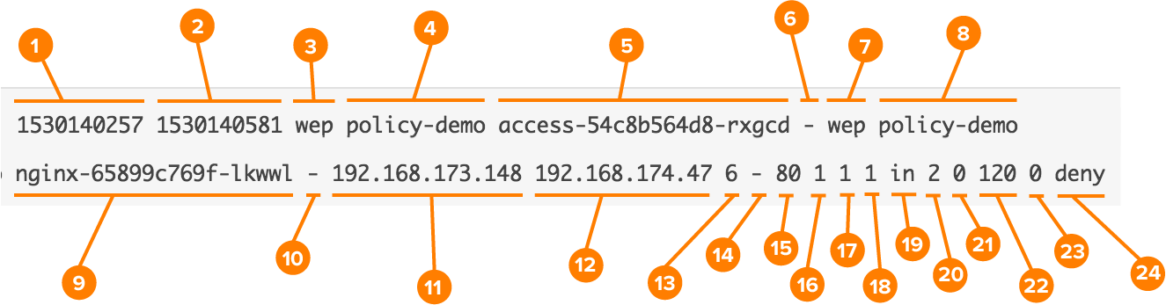
Secure Cloud Edition (CE)
Features:
Enterprise Support from Tigera
Host-to-Host IPSEC Encryption
Flow Logs enriched with Kubernetes Workload Metadata
Integration between AWS Security Groups and Network Policies
Notes:
There is another option in this space which is a paid commercial one. Tigera is the company behind Calico and they have a more advanced Enterprise version of the Network Policy Provider with more features.
The main ones are that it can enable automatic and seamless host-to-host encryption, it can provide flow logs enriched with the kubernetes context (ours would just list IPs without that) and it allows for integration with AWS Security Groups similar to ECS.

Slide 40
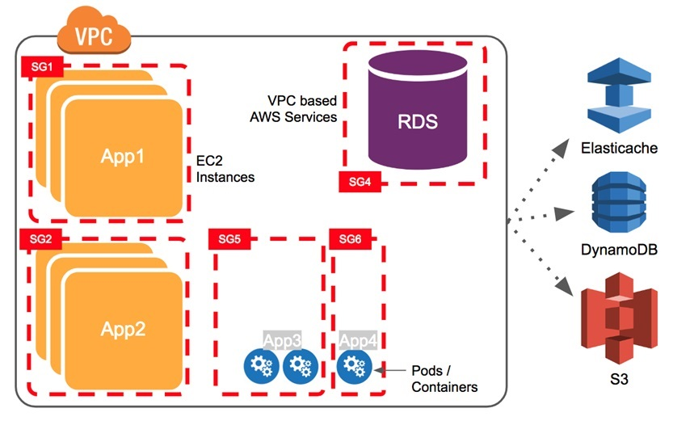
Secure Cloud Edition (CE)
Notes:
This is useful to have rules to say that only these Pods can connect to this Cache or Database and others, which might even be on the same ENI, can’t.

Slide 41
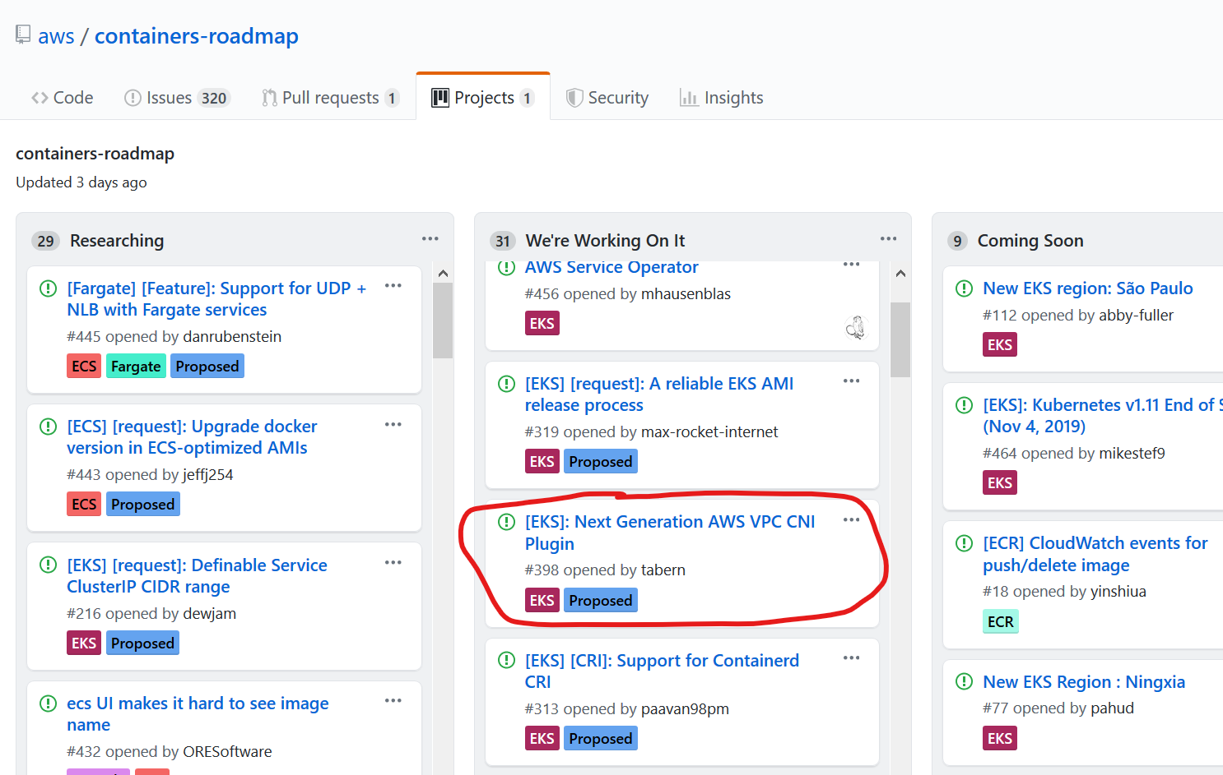
It’s also on our roadmap
Notes:
We have an item on our roadmap to offer similar functionality via our next generation CNI plugin.
Incidentally, the roadmap for AWS’ container offerings are public and on GitHub. Coming Soon is roughly this quarter, We’re working on it is roughly next quarter and in Researching we are being up-front of what we’re thinking of doing – and you can comment and collaborate on those items with the team there!
Just Google AWS Container Roadmap and it should be the first result.

Slide 42
Shared Responsibility Model
Customer Data
Responsible for Security “in” the cloud
CUSTOMER
Applications
Platform
Identity & Access Management
Operating System
Network and Firewall Configuration
Compute
Storage
Database
Networking
Responsible for Security “of” the cloud
AWS
Regions
Availability Zones
Edge Locations
Notes:
Next we’ll talk a bit about customer’s responsibilities around the Instances to run the containers. This covers not just management of the Instances within the platform but also everything at the Operating System level and up.

Slide 43

EC2 Mode – Customer Responsibilities
Instance type and quantity to choose?
What is the CPU to RAM ratio?
Excess capacity for scaling and availability?
Which OS to choose?
If Amazon Linux we provide AMIs
Hardening the OS (e.g. against CIS benchmark)
The patching of the OS, Docker, ECS Agent or kubelet etc.
Photo & Licence
Notes:
These responsibilities include:
What instance type should you use. This depends on the CPU and Memory requirements of your Tasks or Pods and what ratio of CPU to memory you need.
Which Operating System you should choose. We recommend, and even provide supported and regularly updated AMIs for, Amazon Linux - but you are free to use whatever Linux you want. I’ve worked with customers that have successfully used RHEL or Ubuntu instead because that is what they have standardised on and staff are familiar with etc.
Any hardening of that OS – I often hear that there is an internal requirement to harden to a CIS Level 1 standard etc. Since you are responsible for this OS you’d be responsible for that.
And, finally, any patching of the OS as well as anything running on top of it - such as Docker and the ECS Agent or Kubernetes kubelet.

Slide 44
Shared Responsibility Model - Fargate
Customer Data
Responsible for Security “in” the cloud
CUSTOMER
Applications
Identity & Access Management
Network and Firewall Configuration
Operating System
Compute
Storage
Database
Networking
AWS
Platform
Regions
Availability Zones
Edge Locations
Responsible for Security “of” the cloud
Notes:
Eliminates the need for customers to create or manage EC2 instances for their Amazon EKS clusters
Customers no longer have to worry about patching, scaling, or securing a cluster of EC2 instances to run Kubernetes applications in the cloud.

Slide 45
Updating EKS
Kubernetes has a new major version every quarter
Kubernetes has a new minor version quite regularly
Sometimes Kubernetes updates are security-related
EKS has APIs to trigger an update of the control plane
You then need to update the worker Nodes - both re: Kubernetes as well as Docker and OS
Often the workers are in an Autoscaling Group so this means building updating AMIs
We provide a regularly updated EKS Node AMI as well as scripts to build your own.
Notes:
When we talk about patching, there is more to know when it comes to EKS. Kubernetes has a new major version every quarter and minor versions more often than that. Given that some of these minor versions contain critical security patches you need to be able to safely and seamlessly update both the control plane and its worker nodes at a moments notice.
EKS has an API to trigger an update to the control plane which is what you do first. You then need to update the worker nodes. Sometimes you may need to update the worker nodes just to patch their OS rather than to update Kubernetes as well.
Since these workers are usually in an Autoscaling group that means updating them via rolling out new instances from a new Launch Configuration and AMI. We provide both AMIs as well as instructions for how to build them and update them in our documentation.
It is very important that you learn how to do this and do it regularly to get the process down pat.

Slide 46
Monitoring
Introduction to Amazon EKS

Slide 47
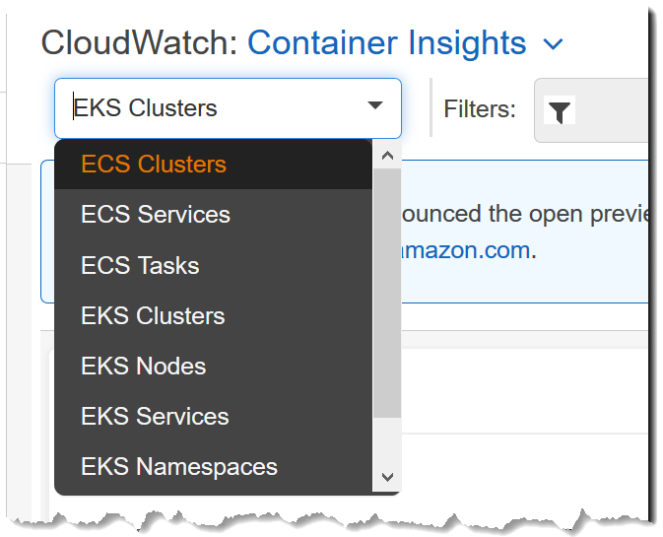


Two ways to collect and monitor metrics in your cluster
You can use the CNCF’s Prometheus to aggregate / alert on your Cluster, Node and Pod metrics and Grafana to visualize them into a dashboard.
We cover how to set those up on your cluster in https://eksworkshop.com
You can use our new CloudWatch Container Insights
to aggregate, alert and visualise those same metrics in the same place as all of your other AWS-related metrics.
Notes:
Out of the box EKS doesn’t have a default setup for collecting, aggregating, alerting on or visualizing your metrics. There are two common patterns I am seeing that customers add to their cluster to get this functionality.
The first is to leverage the tools that are part of the CNCF ecosystem, Prometheus and Grafana, to do this. This usually means running those on top of your cluster yourself. We cover how to set them up as part of our eksworkshop – which is worth checking out as it helps you to add the usual things you’ll need to make your cluster production-ready like this.
Alternatively, we recently launched CloudWatch Container Insights so we can do this all for you as a managed service within CloudWatch – which if you do other things on the AWS platform is where all those other metrics will be.

Slide 48
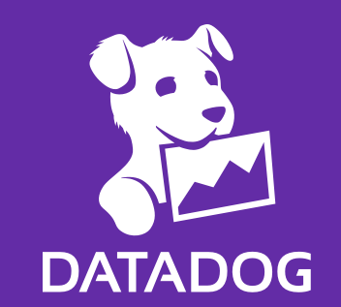


Or one of the commercial SaaS offerings that work with EKS
Notes:
Of course there are many commercial SaaS vendors that can help you with your metrics. Here are just a few that work well with AWS and EKS.

Slide 49

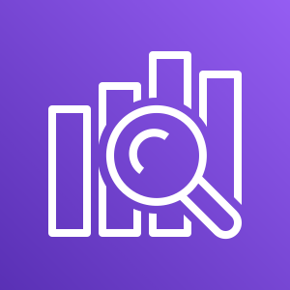

Two ways to collect and monitor logs in your cluster
A common pattern using fully open tooling is collecting logs with fluentd to stream directly into an Elasticsearch where you’ll query/visualise them with Kibana – this is often called the EFK stack.
While you can run all these components yourself on your cluster, we’d encourage you to use the managed Amazon Elasticsearch (which also includes Kibana).
You can also use fluentd to send the logs to CloudWatch Logs. This may entirely meet your needs or you can also optionally stream them elsewhere too.
Often I see customers send them to CloudWatch Logs with a low retention as a place you can search or tail them if Elasticsearch is down for any reason then ship them to Elasticsearch or Splunk from there.
Amazon Elasticsearch Service
Amazon CloudWatch

Slide 50



Or one of the commercial SaaS offerings that work with EKS
Notes:
Of course there are many commercial SaaS vendors that can help you with your logs. Here are just a few that work well with AWS and EKS.

Slide 51
Multiple NodePools / Instance Types (e.g. mixing in GPU, Spot and Windows)

Slide 52
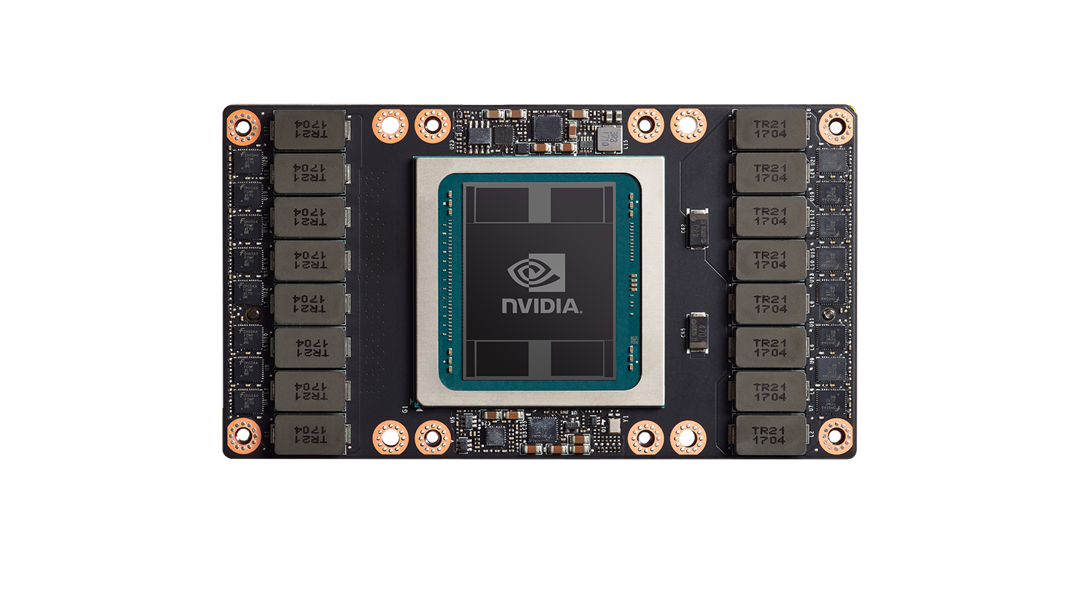
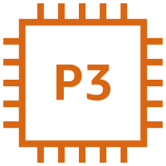
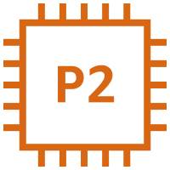
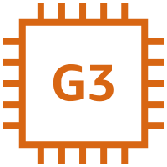
You can use GPU-enabled instances in EKS
AWS has several instance types that have GPUs in them such as our new p3s.
These instance types are useful for things like Machine Learning and other computationally intensive things that can benefit from massive parallelisation.
It is possible to have some of them in a separate NodeGroup within the a mixed-use cluster and then use Kubernetes’ taints and tolerations to ensure that only those workloads that benefit from the GPUs get scheduled on those instances.
Notes:
- The Amazon EKS-optimized AMI with GPU support

Slide 53

You can use spot instances with EKS
AWS sells instances that are currently sitting unused at a discount of up to 90%.
The catch is that if a customer comes along and wants to pay the OnDemand or Reserved pricing for that instance we’ll take it back with a two-minute warning.
It is possible to have either a cluster totally running on Spot (and a few tricks to make that safe-ish) or a mixed cluster with a foundational capacity of OnDemand with bursting out to Spot when it is affordable.

Slide 54
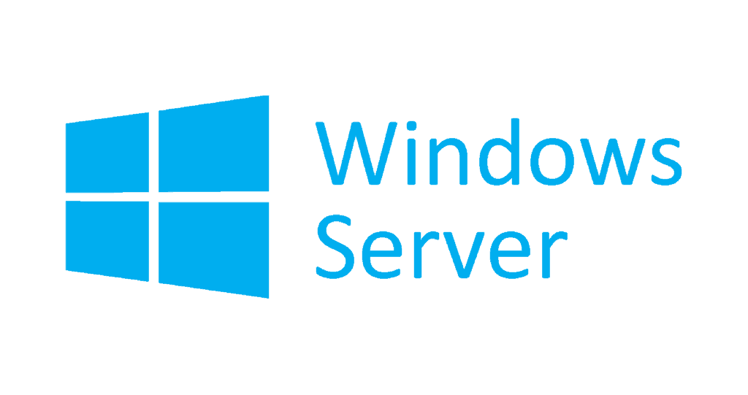
You can now add Windows nodes to your EKS cluster
We’ve just announced that adding Windows nodes to your EKS cluster is now Generally Available.
A couple provisos to Windows Server Containers generally that extend to Kubernetes:
Half of Windows is in each container
The windows version in the container image must match the host OS
Also all the containers/sidecars in the Pod need to run on the same host/OS.
Notes:
Kubernetes version 1.14 or later

Slide 55
Amazon EKS Announces a 50% Price Reduction
$0.10 per hour for each Kubernetes cluster that you run
Effective from January 21, 2020
All AWS regions that support EKS

Slide 56
Questions?
Introduction to Amazon EKS

